Slide 1
Smart Traffic System
A project for embedded electronic engineering lab
Team: MAINZ
Yigitcan Aydin
Syed Rafsan Ishtiaque

Slide 2
Conventional traffic system >> Depends on the decision of the algorithm that most of the times doesn’t update itself with respect to the actual condition
Our project >> Construction of a smart traffic system that can overcome the lacking of the conventional system and make the junction crossing automated

Slide 3
Proposed Algorithm
FIFO (First In First Out) algorithm
Allow the cars pass through the intersection according to their priorities in the FIFO queue

Slide 4
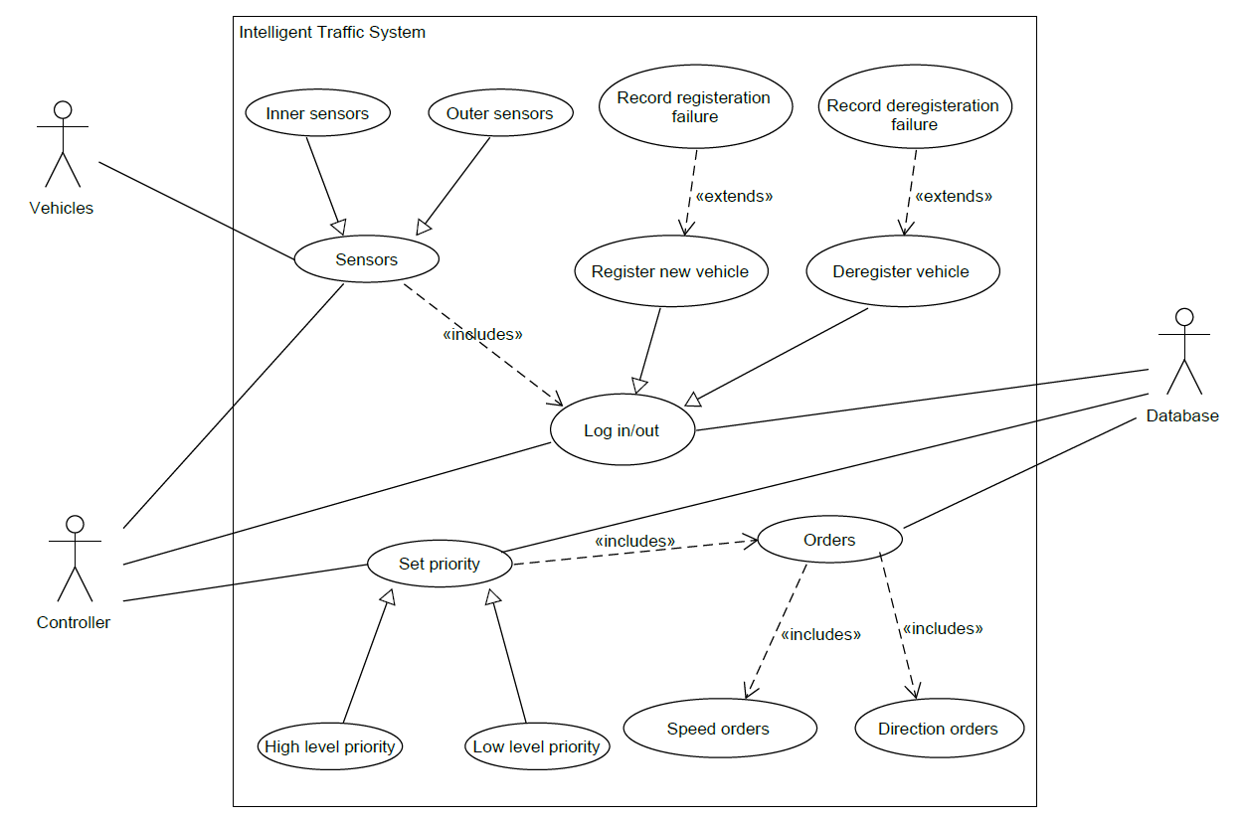
Use Case

Slide 5
UPPAAL Modelling

Slide 6
C++ CODE IMPLEMENTATION

Slide 7
FREERTOS SIMULATION

Slide 8
VHDL IMPLEMENTATION

